Slide 1
LITERATURE REVIEW
Notes:
Useful books for creating MATLAB solver:
Fundamentals of engineering numerical analysis – Parvis Moin
Stability and transition in shear flows – Peter Schmid
From reading papers:
In introduction section, at the end give an overview of what the rest of the paper will present

Slide 2
Self-similarity of strongly stratified inviscid (i/v) flows
UNDERSTANDING CONCEPT OF STRATIFICATION AND QUANTIFYING THIS PHENOMENA including governing equations

Slide 3
Remarks
Concept of stratification
Scaling methods
Governing equations and scaling analysis
Concept of stratified turbulence

Slide 4
Stratification
Stable stratified flows
Lower density fluids rise
Flow disturbances - gravity relaminarizes flow. Vertical displacements are inhibited
Flows are predominantly horizontal but develop strong vertical variations – reorganise into decoupled horizontal layers

Slide 5
Stratification Measures
(Horizontal) Froude number, Fh = U/(N*Lh)
U – horizontal velocity
N – Brunt-Vaisala (BV) frequency; stratification factor
Lh – horizontal length
Strong stratification defined by Fh<<1 (since N is large)
Lh and U are control variables
Lv – vertical length
Lv = U/N
Delta = Lv / Lh (Aspect Ratio)

Slide 6
Governing Equations
Boussineq approximation?
Navier-Stokes equation with added density perturbation term
Perturbation term -> -( (rho’’)g/(rho_0)
rho’’ = density perturbation
g = gravity constant
rho_0 = reference density
Eq(4) ??
Eq (1) – (4) -> dimensional governing equations

Slide 7
Governing Equations - Scaling
Eq (7) – (10) -> RMWL (?) dimensionless system
Valid only for Fh << 1 and delta >= Fh
Use transformations in Equation (6)
Eq (11) – (14) -> Assume Froude number squared is negligible
Eq (15) – (18) -> Assume delta = Fh and Froude number squared is negligible
Eq (24) – (27) -> Assume delta = Fh
Use transformations in Eq (23)

Slide 8
Stratified Turbulence
Transition to highly anisotropic layered turbulence
Observed in oceans and atmosphere
Study of stratified turbulence using Eq (24)-(27) not done in present paper
Strongly stratified turbulence different from 2D turbulence
Vertical stretching of vertical vorticity is possible
Horizontal velocity no longer divergence free

Slide 9
Final Comments
Lv is not a control variable
In strongly stratified flow, i.e, Fh <<1, i/v equations are self-similar to vertical Froude number when Lv is not a controlled input
Self-similarity arises from acceleration term in Eq (2) is negligible when Fh <<1
This makes Lv = U/N so scaling is fixed
Using this vertical length scale, Eq(24)-(27) could be determined
They describe a mixture of layered vortices

Slide 10
Questions
Feedback
Self-similarity?
Could high stratification stabilise flows and prevent transition?
Do these layered structures have interfaces? Discontinuous jumps in density?
Plan for next week:
Layer formation and relaminarisation of Couette flow with spanwise stratification

Slide 11
Layer formation and relaminarisation for in plane Couette flow with spanwise stratification
Effects of HSPC FLOW and investigating stratified turbulence Suppression

Slide 12
Remarks
(1) Introduction
Stratified turbulence
Studied flows
(2) Formulation
Boussinesq equations
(3) DNS
Subcritical turbulence
Layers
Relaminarisation
(4) Linear instability and supercritical transition
Linear unstable region can lead to supercritical transition
(5) Conclusions

Slide 13
(1) Stratified Turbulence
Turbulence in stable stratified flows we observe formation of layers separated by layers
Presence of density interface with sharp gradients
Relevant to atmosphere and oceans
Interfaces act as barriers to mixing and transport
Stratification suppress vertical velocities, due to gravity (restoring force)
When stratification is large -> highly anisotropic flows (flow properties different in certain directions)

Slide 14
(1) Studied flow
Base flow -> Horizontal Shear -> plane Couette flow (pCf) -> Spanwise Stratification
HSPC (Horizontal Stratified Plane Couette)
Velocity gradient is orthogonal to density gradient -> horizontal shear
Velocity gradient parallel to density gradient -> vertical shear
Vertically sheared flows -> weak stratification supresses turbulence -> flow geometries of AR < 10 [AR = Lv / Lh]
When flow is linearly unstable, but below relaminarisation boundary, transition occurs supercritically

Slide 15
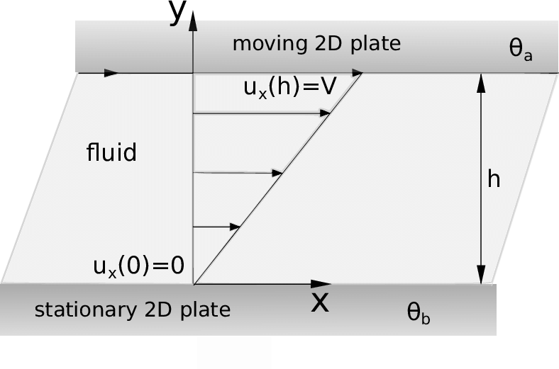
(1) Couette flow

Slide 16
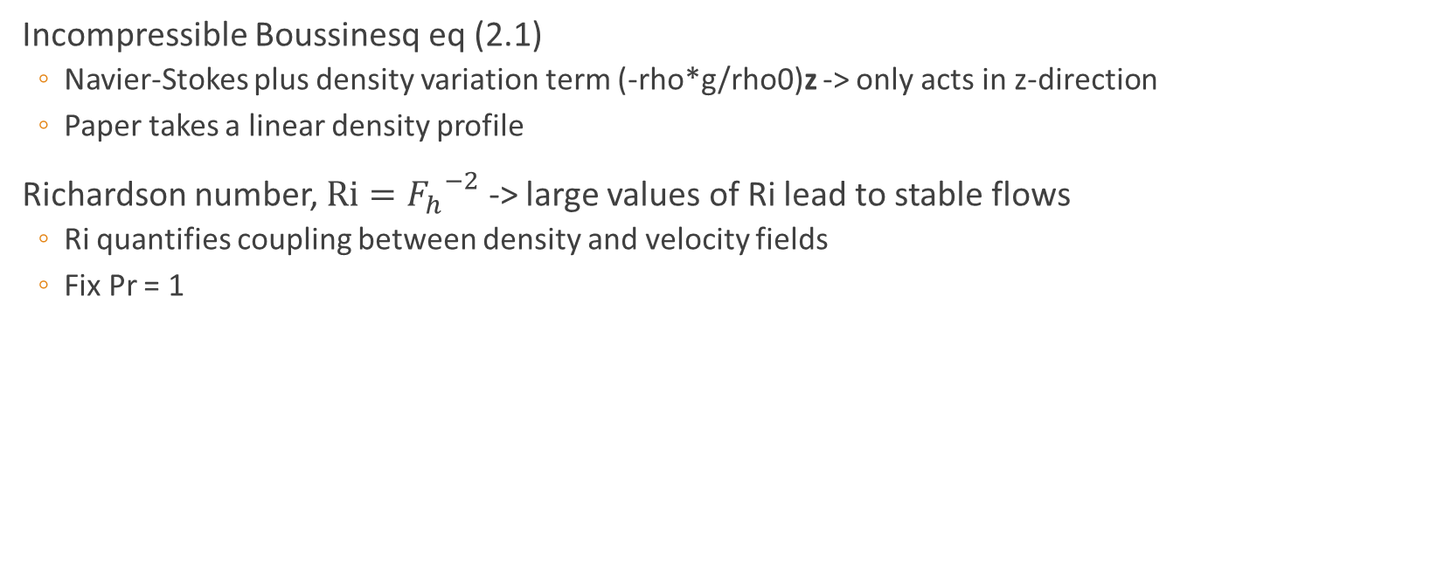
(2) Formulation
Incompressible Boussinesq eq (2.1)
Navier-Stokes plus density variation term (-rho*g/rho0)z -> only acts in z-direction
Paper takes a linear density profile
Richardson number, $Ri={F_{h}}^{−2}$ -> large values of Ri lead to stable flows
Ri quantifies coupling between density and velocity fields
Fix Pr = 1

Slide 17
(3) DNS: Subcritical turbulence
Coordinate system:
x -> flow direction
y -> stream-normal
z -> spanwise (stratification) direction
Horizontal shear, larger stratifications for turbulent flows are achievable than vertical for high Re
Figure 1: Run simulations of Ri versus Re
Black dots represents boundary for where flow relaminarizes
Lx (flow direction); circles Lx = 4pi, squares Lx = pi
Dashed blue line -> theoretical model of relaminarisation boundary for wall-normal stratified pCf
Grey region -> relaminarisation region
Green region -> prone to primary linear instability
Grey region extends into green region

Slide 18
(3) DNS: Subcritical turbulence
Investigating effects of spanwise stratification on pCf dynamics and whether flow can remain turbulent at strong stratifications
Figure 2: Flow field at Re = 5000, Ri = 0.1
Ri = 0.1 -> largest possible stratification at that Re where subcritical turbulence can be sustained
Not obvious influence of stratification

Slide 19
(3) DNS: Layers
Figure 3: Spatio-temporal diagram, case Re = 5000, Ri = 0.1
(a,b) plots the density perturbation
(c,d) plots the total density
Both plots in (z,t) plane
Near-wall profiles (y = -0.98) -> spontaneous formation of layers of alternating weak/strong stratifications
Mid-channel (y = 0) -> flow is uniformly stratified
Figure 4: Given robustness of near-wall layers, plots of (y,z) with increasing Re, Ri
Coherent layers are found with decreasing vertical scale
Associated with layering is coherent pattern in mean flow

Slide 20
(3) DNS: Layers
Figure 5: Same case Re = 5000, Ri = 0.1, shows streamwise and time-averaged velocity components of flow
Vortex structure -> vertical motion -> zig-zag pattern
Streamwise vortices emerge coupled with density layer
Figure 6: Streamwise wall-normal velocity
As stratification increases, limits the secondary flow to swallower vertical scale
Figure 7: Estimate of streamwise roll for certain Ri
Increasing Ri reduces size of the secondary flow

Slide 21
(3) DNS: Relaminarisation
The next largest spanwise length scale in pCf is inner streak spacing, ls = 100*nu / u_tau
Figure 7: As you increase Ri, ls and lz (buoyancy length) converge to each other
Lz decreases and ls increases
Intersection point represents the relaminarisation point with respect to Ri at a certain Re
Figure 8: Analysis of this convergence, plots y+ against U+ (spanwise spectra)
As Ri increases, the near wall peak stays fixed but buoyancy scale shifts towards it causing relaminarisation – turbulence cannot maintain itself
The suppression mechanism is caused by the stratification
Stratification suppresses the vertical momentum transport -> essential for turbulence maintenance

Slide 22
(4) Linear instability
So far we have neglected stratified linear instability (green region of figure 1)
Here the relaminarisation boundary is disrupted by the linear instability
At larger Re and Ri it is important to consider the influence of linear instability on relaminarisation and maintenance of turbulence
This linear instability can supercritically trigger turbulent dynamics (triangles in Figure 1)
Below the relaminarisation boundary, the turbulence attractor looks unaffected by the new linear instability but can provide a route for small perturbations to excite turbulence

Slide 23
(5) Conclusions
Main finding:
Laminar/turbulent boundary affected by stratification and how it limits turbulence
Mechanism for turbulence suppression is different from flow with vertical shear and stream-normal stratification
In vertically shearing case, buoyancy directly penalises wall-normal flow
Horizontal shearing, wall-normal flow is indirectly penalised via coupling with spanwise velocity in the streamwise rolls
Main reason that higher Ri turbulence can be achieved
Mechanism of spanwise stratification is through streamwise roll suppression
Relaminarisation mechanism is independent of box size and initial conditions
Important to think about orientation of the shear in more industrial flows (pipes and ducts)
Non-trivial orientation for gravity

Slide 24
(5) Final remarks
Stratification useful tool for studying the localisation and control of turbulence in vertically sheared flows
Relaminarisation can be controlled by buoyancy scale

Slide 25
Linear instability of HSPC
HYDRODYNAMIC STABILITY OF HORIZONTAL SHEAR AND VERTICAL STRATIFICATION

Slide 26
Remarks
Paper presents LSA of HSPC (Horizontal Shear, Vertical (span) Stratification, pCf) and investigates influence of Fr and Re on stability
Discusses findings from DNS and Experimental data as a comparison for LSA
Ignored discussions on DNS and Experiments
LSA most significant

Slide 27
(1) Introduction
Motivation: Shear and density stratification coexistence are ubiquitous features of flows on Earth -> effects dynamics of different fluids such as air and oceans
Adding vertical stratification, pCf becomes unstable at moderate Re
Stratification is thought to be a stabilising mechanism as it inhibits vertical motion

Slide 28
(2) Formulation
Coordinate system:
x – streamwise
y – stream-normal (shear direction)
z – stratification direction
Use the incompressible Boussinesq equations
Brunt-Vaisala frequency (Stratification factor), N = sqrt( - [ g/rho0 ] * d(rho)/dz )
Schmidt number, Sc = nu / k
nu is the kinematic viscosity
k is the density diffusivity
Gives us a relation between shear and density stratification

Slide 29
(3) LSA results
Unstratified pCf are linearly stable for all Re
Instability is defined by imag(omega) > 0
Increasing Re increases the growth rate imag(omega)

Slide 30
(3) LSA Conclusions
Linear stability analysis of vertical stratification with horizontal shear
Function of Re and Fr – compares importance of shear and stratification on stability
Flow unstable when Re and Fr are of same order (Fr ~ 1) and Re > 700
Instability results from wave resonance mechanism confirmed by full non-linear DNS
First evidence of instability of vertically stratified pCf
Flow unstable to 3D perturbations
Instability is crucially associated with the shape of the shear, namely the pCf profile

Slide 31
3D stability of a horizontal sheared stratified fluid
Investigating 3D stability of horizontal sheared flow

Slide 32
Remarks
Paper investigates 3D stability of horizontal shear flow in stable vertical stratified fluid
In a homogenous fluid
Squire theorem states most unstable perturbation is 2D
The stronger the stratification, the smaller the vertical scale that can be destabilised

Slide 33
(1) Introduction
Study of shear flows has industrial and geophysical importance
Any 3D unstable mode is less unstable than 2D mode – shear flows are dominated by 2D instabilities
A lot of attention for vertical stratification
Richardson number, Ri = N^2 / S^2
N is the BV frequency (stratification factor)
S is the shear rate

Slide 34
(2) Formulation
Inviscid 3D Boussinesq
N is assumed to be constant
System is linearised in terms of u, v and b (buoyancy)
Numerically solved using Chebyshev transform

Slide 35
(3) Results
If sigma is an eigenvalue for wavenumbers (kx, kz), then it is also an eigenvalue for (kx, -kz)
-sigma is an eigenvalue for (-kx, kz)

Slide 36
Shear instability in a stratified fluid with inalignment
Understanding effect of changing angle of shear with respect to the stratification

Slide 37
Remarks
Paper considers effect of inalignment of stratification and shear
2D plane Bickley jet with width L, max velocity U0, constant N and an inviscid Boussinesq framework
Q: How can we use inviscid approximation for shear flow
When they are aligned, (theta = 0), condition for stability is Ri > ¼
When theta ~= 0, the Bickley jet is found to be unstable for all Fh

Slide 38
(1) Introduction
Stable stratification is known to be stabilising when direction of stratification is aligned along shear direction
When perpendicular, the effect is little
Little is known when they are inclined to each other
Theta is with respect to stratification direction
2D sinuous Kelvin-Helmholtz (KH) mode is the most unstable mode
Investigates how this changes as theta changes
Base flow is Bickley jet flow

Slide 39
(2) Base flow and formulation
Velocity profile
kx and ky are wavenumbers and omega is the frequency
Omega is the important property, imaginary part is the growth rate
System is linearised into A = omega*B

Slide 40
(3) Numerical results
The stability analysis is performed by searching for eigenvalue with largest growth rate for fixed perturbation wavenumbers kx and ky and fixed base flow parameters theta and Fh
For any theta and Fh, the most unstable mode among all 3D perturbations is always 2D sinuous KH mode

Slide 41
(4) Conclusion
The linear inviscid stability properties of an inclined plane Bickley jet was obtained for large range of Fh and theta
When there is an inalignment, jet is unstable for all Fh
Ri > ¼ not valid when theta ~= 0
Most unstable mode is sinuous KH mode
Results can apply to shear layers

